Slide 1
Chapter 5 Loops
Liang, Introduction to Java Programming, Tenth Edition, (c) 2015 Pearson Education, Inc. All rights reserved.

Slide 2
Motivations
Suppose that you need to print a string (e.g., "Welcome to Java!") a hundred times. It would be tedious to have to write the following statement a hundred times:
System.out.println("Welcome to Java!");
So, how do you solve this problem?

Slide 3
Opening Problem
Problem:
System.out.println("Welcome to Java!");
System.out.println("Welcome to Java!");
System.out.println("Welcome to Java!");
System.out.println("Welcome to Java!");
System.out.println("Welcome to Java!");
System.out.println("Welcome to Java!");
…
…
…
System.out.println("Welcome to Java!");
System.out.println("Welcome to Java!");
System.out.println("Welcome to Java!");
100 times

Slide 4
Introducing while Loops
int count = 0;
while (count < 100) {
System.out.println("Welcome to Java");
count++;
}

Slide 5
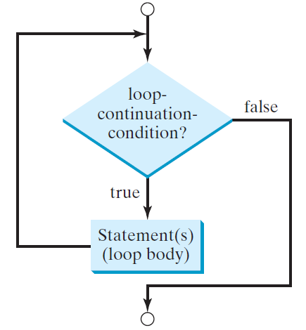
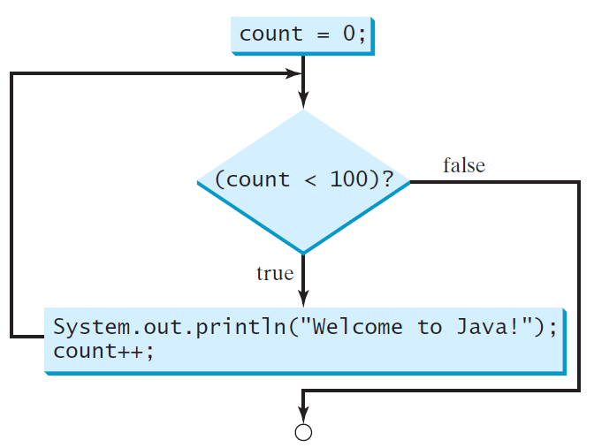
while Loop Flow Chart
int count = 0;
while (count < 100) {
System.out.println("Welcome to Java!");
count++;
}
while (loop-continuation-condition) {
// loop-body;
Statement(s);
}

Slide 6
Trace while Loop
animation
Initialize count
int count = 0;
while (count < 2) {
System.out.println("Welcome to Java!");
count++;
}

Slide 7
Trace while Loop, cont.
animation
(count < 2) is true
int count = 0;
while (count < 2) {
System.out.println("Welcome to Java!");
count++;
}

Slide 8
Trace while Loop, cont.
animation
Print Welcome to Java
int count = 0;
while (count < 2) {
System.out.println("Welcome to Java!");
count++;
}

Slide 9
Trace while Loop, cont.
animation
Increase count by 1
count is 1 now
int count = 0;
while (count < 2) {
System.out.println("Welcome to Java!");
count++;
}

Slide 10
Trace while Loop, cont.
animation
(count < 2) is still true since count is 1
int count = 0;
while (count < 2) {
System.out.println("Welcome to Java!");
count++;
}

Slide 11
Trace while Loop, cont.
animation
Print Welcome to Java
int count = 0;
while (count < 2) {
System.out.println("Welcome to Java!");
count++;
}

Slide 12
Trace while Loop, cont.
animation
Increase count by 1
count is 2 now
int count = 0;
while (count < 2) {
System.out.println("Welcome to Java!");
count++;
}

Slide 13
Trace while Loop, cont.
animation
(count < 2) is false since count is 2 now
int count = 0;
while (count < 2) {
System.out.println("Welcome to Java!");
count++;
}

Slide 14
Trace while Loop
animation
The loop exits. Execute the next statement after the loop.
int count = 0;
while (count < 2) {
System.out.println("Welcome to Java!");
count++;
}

Slide 15
Problem: Repeat Addition Until Correct
Recall that Listing 3.1 AdditionQuiz.java gives a program that prompts the user to enter an answer for a question on addition of two single digits. Using a loop, you can now rewrite the program to let the user enter a new answer until it is correct.
IMPORTANT NOTE: If you cannot run the buttons, see www.cs.armstrong.edu/liang/javaslidenote.doc.
RepeatAdditionQuiz
Run

Slide 16
RepeatAdditionQuiz.java
Page 162 Listing 5.1

Slide 17
GuessNumberOneTime.java
Pages 164 Listing 5.2

Slide 18
Problem: Guessing Numbers
Write a program that randomly generates an integer between 0 and 100, inclusive. The program prompts the user to enter a number continuously until the number matches the randomly generated number. For each user input, the program tells the user whether the input is too low or too high, so the user can choose the next input intelligently. Here is a sample run:
GuessNumberOneTime
Run
GuessNumber
Run

Slide 19
GuessNumber.java
Pages 165 Listing 5.3

Slide 20
Problem: An Advanced Math Learning Tool
The Math subtraction learning tool program generates just one question for each run. You can use a loop to generate questions repeatedly. This example gives a program that generates five questions and reports the number of the correct answers after a student answers all five questions.
SubtractionQuizLoop
Run

Slide 21
SubtractionQuizLoop.java
Pages 166-7 Listing 5.4

